Slide 1
Terrain Classification Using Monocular Camera

Slide 2
Topics
Motivation
Training Image
Feature Vector
Data Set
Classifiers
KNN
Random Forests
Neural Networks
SVM
Linear
Polynomial
Rbf
0-1 Loss Comparison
Remaining Tasks

Slide 3
Motivation
The problem that we are trying to address -> Terrain classification
Autonomous navigation
Perception
Terrain Classification
Sensors
Laser Range Finder costly
Inertial Measurement Unit
Cameras - cheap

Slide 4
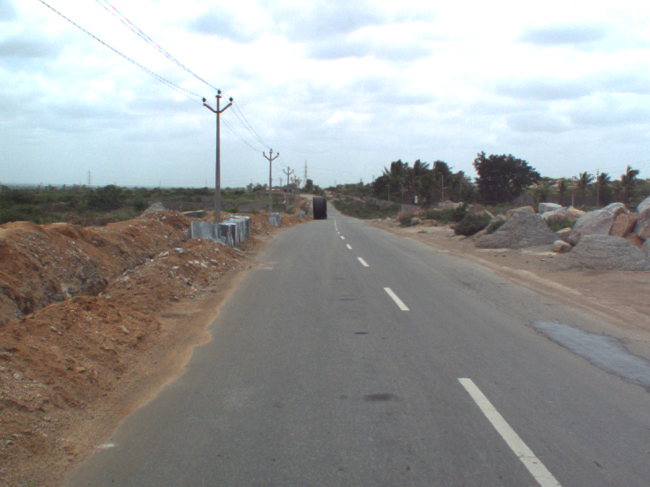
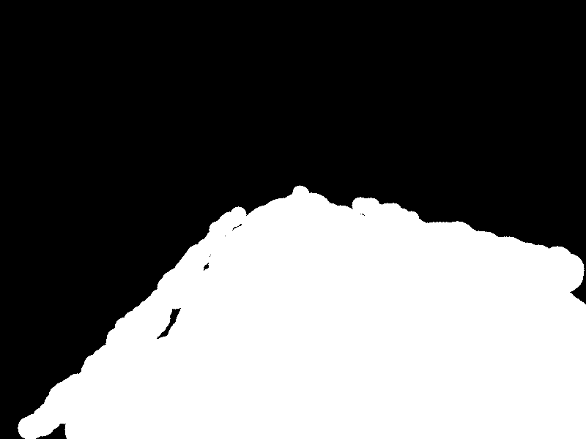
Training Image
100 Data images (800x600) & 100 Label images (800x600)

Slide 5
Feature Vector
Each Data image is divided into 1200 patches of size 20x20
Histograms
3 histograms/per patch each for a color channel (RGB)
Bin size 10
Output 1x10 vector/color channel -> holding frequency of each bin
Feature vector
Concatenation of above 3 vectors (1x30)

Slide 6
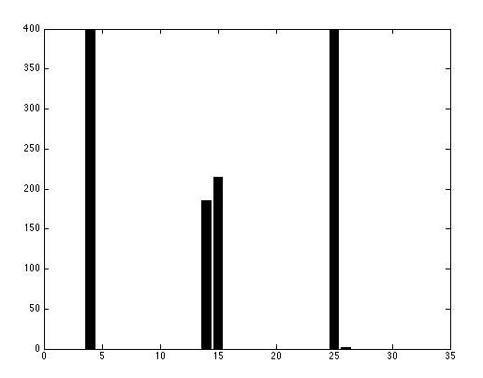
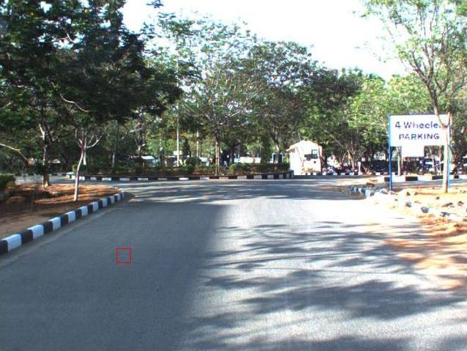
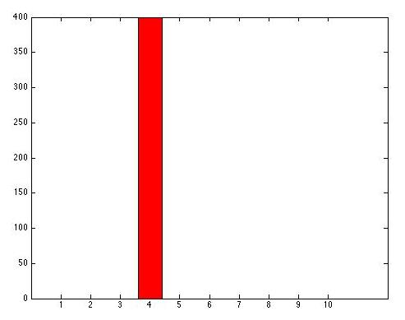
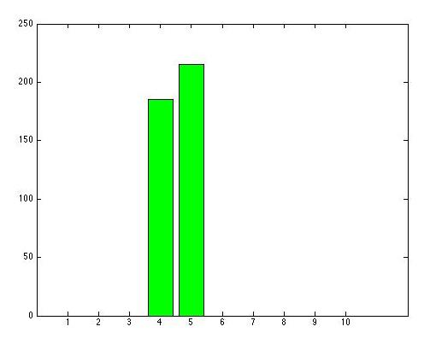
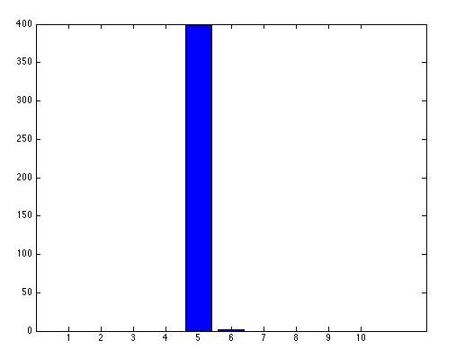
Feature Vector

Slide 7
Data Set
Each Data image is divided into 1200 patches of size 20x20
Total No. Of Images =100
Total Feature vectors or Data Points= 120,000
Holdout Data = DataPoints/6 = 20,000
Training Data = DataPoints*5/12 = 50,000
Testing Data = DataPoints*5/12 = 50,000

Slide 8
Classifiers
KNN
Random Forests
Neural Networks
SVM
Linear
Polynomial
Rbf

Slide 9
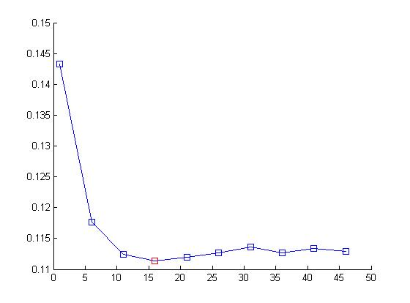
Parameter tuning: KNN
Error
K
Knee is at K =16
Error =0.1060

Slide 10
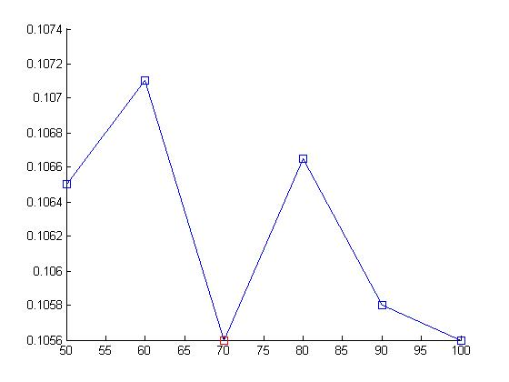
Parameter tuning: Random Forests
Optimum Number of trees = 70
Error = 0.0977

Slide 11
Neural Networks
Parameter Tuning is yet to be performed
Default Parameters used
Number of hidden nodes =10
Error = 0.1058

Slide 12
SVM
SVM failed to converge for huge data sets
Only 12000 data points were used

Slide 13
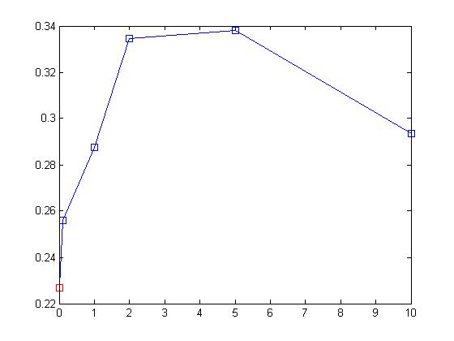
Parameter tuning: SVM (linear)
C = 0.0700
Error =0.3092

Slide 14
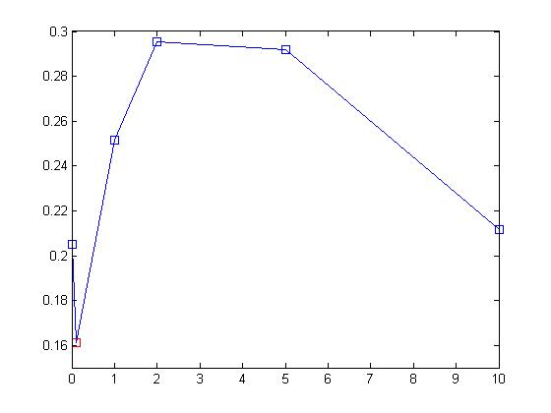
Parameter tuning: SVM (Polynomial)
C = 0.1000
Error =0.3400

Slide 15
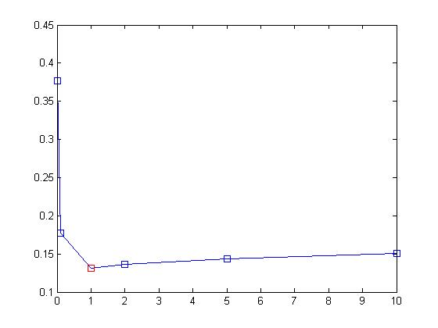
Parameter tuning: SVM (rbf)
C = 1
Error =0.1196

Slide 16
0-1 Loss Comparison
Classifier | 0-1 Loss
KNN | 0.1060
Random Forests | 0.0977
Neural Networks | 0.1058
Chance | 0.4000
Classifier | 0-1 Loss
SVM Linear | 0.3092
SVM Polynomial | 0.3400
SVM rbf | 0.1196

Slide 17


Slide 18
Remaining Tasks
Successfully executing SVM for larger Data Set
Tuning Parameters for Neural Networks

Slide 19
Thank you

